Slide 1
Arkansas Tech University
Jasmine Hattabaugh
Bekah Hickman
Brooke Boyd

Slide 2
Professional Development Series: Transgender Students and Their Collegiate Experience

Slide 3
Learning Objectives
After this presentation, the senior staff will understand:
The challenges for transgender students in higher education.
Common perceptions of transgender people due to socialization.
Student development theories focused on transgender students.
Programs and services the Student Services professional development team suggests the University should implement.

Slide 4
Defining “Transgender”
Notes:
The term transgender encompasses a wide range of identities, appearances, and behaviors that blur or cross gender lines. Within this transgender umbrella are transsexuals, who live some or all of the time in a sex different from their biological sex; cross-dressers (formerly called transvestites), who wear clothes typically associated with the “opposite” gender; drag kings and drag queens, who cross-dress within a performance context; and genderqueers, who identify outside of binary gender or sex systems” (Beemyn, 2005).

Slide 5
Statistics
According to GLAAD, transgender Americans are becoming strong statistics.
90%
41%
72%
90%
16%
8%
27%
9%
Notes:
“90% of transgender people report experiencing harassment, mistreatment or discrimination…”
“41% of respondents reported attempting suicide, compared to 1.6% of the general population”
“Transgender people are four times more likely to live in poverty”
“72% of anti-LGBT homicide victims were transgender women”
“90% of Americans say they personally know someone who is lesbian, gay, or bisexual”
“Only 16% of Americans say they personally know someone who is transgender, which has doubled from the 8% who said so in 2008. 27% of millenials, 9% over 45 years”

Slide 6
D’Augelli’s Transgender Identity Development Theory
Existing traditionally gendered identity
Process of understanding gender is a type of identity and the role it plays in the life of an individual
Developing personal transgender identity
Takes place when a transgender student is identifying his/her identification
Developing transgender social identity
The stage a transgender student forms a support group
Becoming transgender offspring
Communicating his or her identity to their parents/grandparents and the reactions and consequences of the revelation.
Developing transgender intimacy status
Occurs once the student has a positive self concept allowing them to share their identity to a romantic partner
Entering transgender community (Evans, Forney, & Guidio-DiBrito, 1998)
The transgender student joins a community with similar beliefs and social actions.

Slide 7
A Personal Perspective About Life Identifying as Transgender
https://www.ted.com/talks/lee_mokobe_a_powerful_poem_about_what_it_feels_like_to_be_transgender#t-237771
Notes:
https://www.ted.com/talks/lee_mokobe_a_powerful_poem_about_what_it_feels_like_to_be_transgender#t-237771

Slide 8
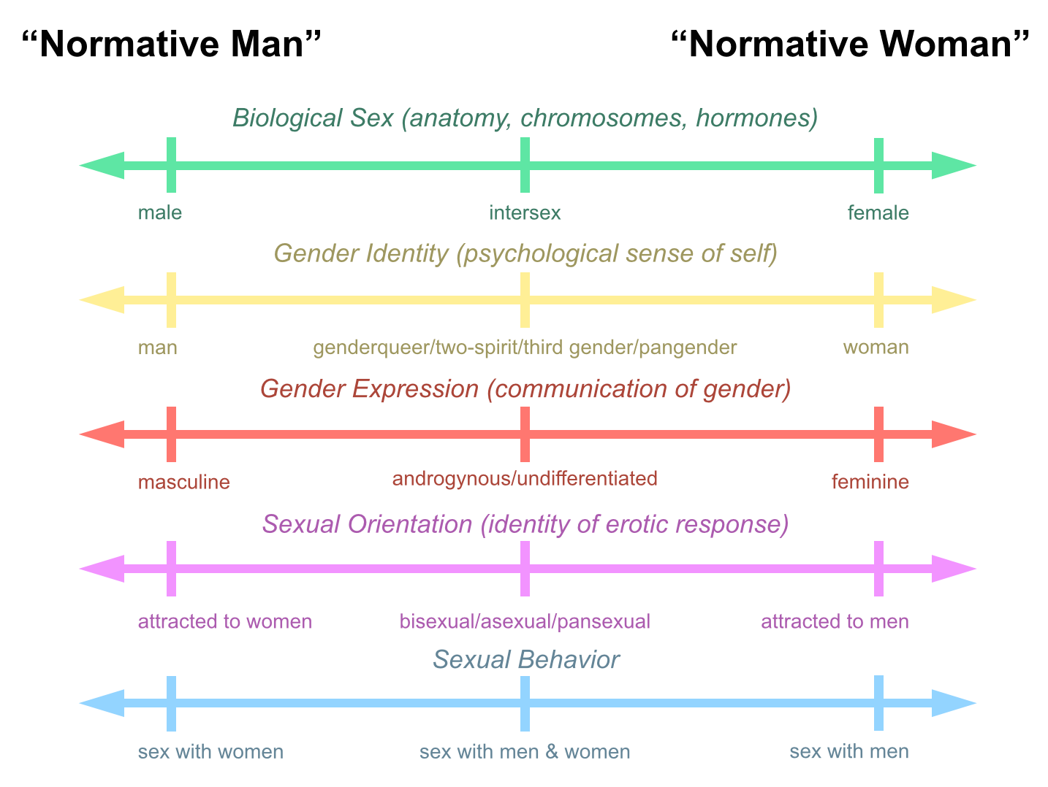
Diagram of Sex, Gender, & Sexuality (Center for Gender Sanity, 2009)

Slide 9
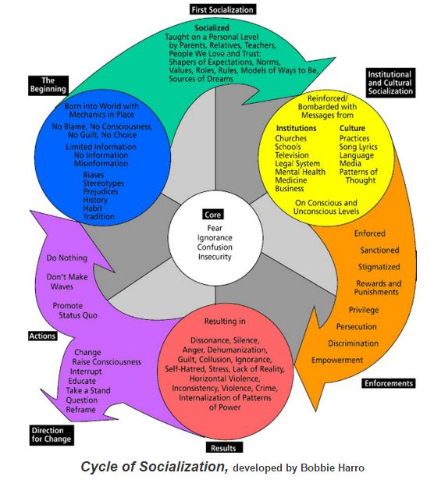
Cycle of Socialization
If we want to inspire a culture of inclusion, we must break the cycle of socialization.
file:///Users/Jasmine/Downloads/Cyclye%20of%20Socialization-Liberation.pdf

Slide 10
Emotional Stressors
Struggle between gender feelings and societal messages
Self doubt
Feelings of inadequacy due to homophobia
Inability to develop socially due to belief of negative stereotypes
Alienation and loneliness
Inability to cope with prejudices due to inability to learn from parents
Difficulty finding supportive relationships

Slide 11
Situations and Discrimination
Programming
On-Campus Facilities
Counseling and health care services
Correct Identification and Policy
Notes:
Transgender students are likely to encounter discrimination on campus in various places and situations. Some examples include programming, housing, bathrooms, and locker rooms, counseling and healthcare services, and records classroom expectations and situations of being identified incorrectly.
Now we would like to discuss each of these individually and provide suggestions on how to improve in each of these areas.

Slide 12
Correct Identification and Policy
Identify those whom identify as transgender in both the Registrar’s Office and Human Resources.
Create one procedure for changing names and gender identifications on all institutional records.
Provide education to gender-based groups on campus.
Implement an anti-transgender bias campaign, which is included into the institution’s response system.
Adopt a campus diversity statement that includes the transgender community.
Notes:
When identifying areas in which transgender students may experience discrimination records and classrooms are areas that are most frequented.
Although these instances occur there are several measures that can be implemented to ensure that transgender students feel safe and important.
The first of which is to identify and publicize the names of individuals who identify as transgender with in the registrars office and human resources. These offices should have the capabilities to facilitate name and gender changes on all documents, including identification cards, and be a one stop procedure for those in transition to change their name and gender identification for all records throughout the institution.
Another Way to avoid discrimination is to educate groups that are organized along gender lines about the need for gender inclusion.
A great action to take is to make anti-transgender biases against campus policy and include this into the response systems throughout the institution.
Finally one of the most important changes that an institution can make to support their transgender students is to adopt a campus diversity statement that includes transgender people. This statement should also include an anti-harassment policy that includes both gender expression and identity.

Slide 13
Counseling & Healthcare Services
Train all staff
Gender Specialist counselors
Reach out to pharmacies near the university
Allow patients to use preferred names
Gynecological exams
Notes:
Trained counselors available, require all campus healthcare staff on transgender health, enable patients to identify their preferred name and identity on intake forms, make gynecological exams available outside of women’s health services, hire therapist who is trained gender specialist, have campus-affiliated pharmacies stock hormones and intramuscular syringes

Slide 14
On-Campus Facilities
Provide residence hall accommodations that ensure safety and comfort
Create gender-neutral bathrooms and locker rooms.
Encourage all students to utilize these facilities.
Ensure the facilities are safe.
Provide proper education regarding facility usage.
Notes:
The facilities that most commonly prove to be difficult for transgender students include housing bathrooms and locker rooms. Although these can be a source of difficulty.
Several measures can be put in place to ensure the best outcome for all involved.
An important thing to remember for transgender students is that they should feel safe. In residence halls, institutions should provide accommodations for the students safety and comfort. Any possible way of ensuring this is to provide single occupancy rooms.
Next, institutions should create gender-neutral bathrooms in residence halls and other campus buildings. These bathrooms will not just specifically be for transgender students, but for all students. The institution should encourage students that they should use these bathrooms as well.
While these facilities are being put in place the institution should ensure that they are safe by taking measures such as installing locking stall doors and privacy barriers. Proper education over the use of these facilities should be provided for those of whom will be on campus.

Slide 15
Programming
Here are some recommendations from Beemyn on how to improve campus programming:
Celebrate Transgender holidays
Create resource guides
Establish groups on campus
Make all events more inclusive
Train all members of our community
Notes:
Have an event/activity to commemorate the annual transgender day of remembrance (Nov. 20)
and hold trans-related events during LGBTQ pride weeks and awareness months,
create a web-based campus resource guide for new and perspective trans students,
establish a transgender RSO or support group,
provide training sessions on trans issues to all campus staff and students,
include trans-focused and –inclusive programs as part of general campus programming

Slide 16
Action Plan
Administer survey to current University population to determine success of current programs, need for programming and perception of the transgender community.
Update current policies to best accommodate students and campus climate changes.
Provide training to all members of our University community on transgender students and their needs.
Implement the aforementioned programs and services for our student body.
Administer the same survey once a year for five consecutive years, to gather information on how said changes are being perceived and utilized.

Slide 17
References
Beemyn, B., Curtis, B., Davis, M., & Tubbs, N. J. (2005). Transgender issues on college campuses. New Directions for Student Services, 2005(111), 49-60. http://vp.studentlife.uiowa.edu/assets/Transgender-Issues-on-College-Campuses.pdf
Beemyn, B. G. (2005). Making campuses more inclusive of transgender students. Journal of Gay and Lesbian Issues in Education, 3(1), 77-87. https://libcatalog.atu.edu:443/login?url=http://search.ebscohost.com/login.aspx?direct=true&db=a9h&AN=19565460&site=ehost-live&scope=site
Bilodeau, B. L. & Renn, K. A. (2005). Analysis of LGBT identity development models and implications for practice. New Directions for Student Services, 111, 25-39. https://msu.edu/renn/BilodeauRennNDSS.pdf
Center for Gender Sanity. (2009). Diagram of sex and gender. Retrieved from http://www.gendersanity.com/diagram.html

Slide 18
References Continued
Evans, N. J., Foreny, D. S., & Guido-DiBrito, F. (1998). Student development in college: Theory, research, and practice (pp. 96-98).
Seelman, K. L. (2014). Recommendations of transgender students, staff, and faculty in the USA for improving college campuses. Gender & Education, 26(6), 618-635. doi: 10.1080/09540253.2014.935300
Transgender FAQ. (2013). Retrieved February 24, 2016, from http://www.glaad.org/transgender/transfaq
Wollenshleger, M. (2013). Gender and sexuality development theories. Student Development Theories. https://studentdevelopmenttheory.wordpress.com/gender-and-sexuality/
Zubernis, L. & Snyder, M. (2007). Considerations of additional stressors and developmental issues for gay, lesbian, bisexual, and transgender college students. Journal of College Student Psychotherapy, 22(1), 75-79. doi: 10.1300/J035v22n0106

