Slide 1
Making a More Welcoming Environment for Transgender Students at Centrist College
Creating a Brand:
Victoria Sexton, Tiger Simpson & Cory Moen
University of Central Missouri
Notes:
(Note: these notes are compiled to show how we would be presenting this information verbally to the group.)
Hello, and thank you for meeting with us today! We are Victoria, Cory, and Tiger, and we work with Student Services here at Centrist College. We appreciate you taking the time to join us today to talk about creating an inclusive environment for transgender students.

Slide 2
Overview
Situation
Transgender and non-binary students face unique struggles on a college campus.
Little and big actions from staff and faculty can help or harm these students in their development, both as a student and as a member of the transgender community.
This is a newer “hot topic” on college campuses, and research is still being done on it.
What we’re doing right
We are discussing it!
Keeping calm/tranquil
What we can do better
Continue the conversation: education
Creating a brand
Notes:
We will start with an overview of the presentation, and of the issue at hand.
As seen in research and in the media, transgender students are becoming more and more common on college campuses. However, it is still a new issue that many people do not understand, or are not comfortable with. Because of this, students within this population have unique struggles. Perhaps a student in transition (that is, a student making progress towards changing their sex to match their gender) may get harassed for using the “incorrect” bathroom. Or perhaps those students who do not “pass” as a certain gender stereotype may experience bullying or violence. These situations may be a daily reality for our students, and we need to be aware that both our little and larger actions can either help or harm these students as they develop in our school. Whether those actions impact an individual person or the community on the whole, it is our job to make the steps towards acceptance and education on the issues.
Luckily, we are discussing it! We have a great leader in Dr. Fogg for recognizing that this is important, even if we have a calm campus environment. The most important first step is education and communication. We will begin this discussion with the ethical and theoretical approaches to helping the transgender population. Next, we will call a plan to action: creating a brand, which will be explained more later.

Slide 3
Let’s Chat Ethics
Kitchener’s (1985) ethical principles:
Act to benefit others
Promote justice
Respect autonomy
Be faithful
Do no harm
Hamrick, F. A., & Benjamin, M. (2009). Maybe I should--: Case studies on ethics for student affairs professionals. Lanham: University Press of America.
Notes:
To begin, let’s chat about ethics. Ethics are important to consider here because they serve as professional guidelines to provide the best services to our students. In fact, the two “umbrella” organizations of student affairs, NASPA and ACPA, have their own ethical standards that are derived from these five principles as proposed by Kitchener in 1985. By starting with an ethical framework, we can determine what our roles as professionals are in helping to create an inclusive environment for all students. We will specifically look at the three most relevant principles: act to benefit others, promote justice, and do no harm.

Slide 4
Kitchener’s (1985) Principles, cont’d
Act to benefit others
Holistic development
Programming and service-oriented events
Promote justice
Fundamental fairness
Equity, not necessarily equality
Demonstrating respect for difference
Opposing intolerance of those differences
Do no harm
Acts and policies that do not threaten self-worth or safety; discriminate; impede with learning
Minority may suffer more or in different ways than majority
Hamrick, F. A., & Benjamin, M. (2009). Maybe I should--: Case studies on ethics for student affairs professionals. Lanham: University Press of America.
Notes:
First, we want to concern ourselves with the holistic development of our students. That is, how the student develops as a whole person: cognitively, behaviorally, socially, etc. Here at Centrist College, we want to promote the importance of giving back and inclusion; at the core of this theory lies acting to benefit others. Demonstrating how we service humanity will ensure that our students will do the same, both in our campus climate and in the spaces they inhabit in society upon graduation. Primarily, our campus can show the importance of acting to benefit others in our programming and service-oriented events. In regards to this particular demographic, this principle is key in thinking about the transgender community. Our actions and behaviors should show the community that we are concerned about the wellbeing of the community, and that we wish to educate those who are not knowledgeable of it.
That leads us to the second principle: promoting justice. This relies on fundamental fairness; making sure that students of any gender has equitable, and not necessarily equal, treatment. We stress equity over equality because transgender folks may need different resources to gain that fundamental fairness. Perhaps the most important factor to consider in this tenant is demonstrating a respect for differences, and opposing intolerance to those differences. We must remember that when working with other students who may not understand the transgender population. The attitudes and behaviors we exhibit can directly relate to the way students handle situations around campus.
That leads us to our last point: do no harm. We must ensure that our policies and procedures do not threaten our students in any way. For example, we must provide flexibility or alternate options for things such as housing and restrooms on campus to ensure that these students can function as any other student might. It is also crucial to realize here that the minority population may suffer more or in different ways than the majority may due to societal advantages and privilege.

Slide 5
Related Theory
Biodeau's (2005) Transgender Identity Development Theory
Exiting a traditionally gendered identity
Developing a personal transgender identity
Developing a transgender social identity
Becoming a transgender offspring
Developing transgender intimacy status
Entering a transgender community
Evans, N.J., Forney, D.S., Guido F.M., Patton, L.D., & Renn, K.A. (2010). Student development in college: Theory, research, and practice (2nd ed.). San Francisco. San Francisco, CA: Jossey-Bass
Notes:
This theory is useful in this situation because understanding a transgender student’s experience is extremely important when working with these students.This theory of transgender identity development has 6 stages, which do not happen in a linear fashion. The first is exiting a traditionally gendered identity. This is where an individual will exit a gender identity they have lived with, the gender or sex assigned at birth. Next is developing a personal transgender identity. In this stage, the development of a transgender identity happens over time and the individual begins to learn what it means to be transgender in their own eyes. Developing a transgender social identity happens when people in the social realm of the person’s life learn about the transgender identification and the person is no longer looked at as what gender they identified as previously, but now as transgender. Becoming a transgender offspring occurs when an individual lets their parents know and the parents make an adjustment in what gender pronoun their offspring prefers because it will be different than what the parents have previously used. Developing a transgender intimacy status happens while in a relationship, or when the individual begins a relationship and they discover what it means to be transgender when intimacy is involved in the relationship. Entering a transgender community happens when an individual meets and becomes part of a group with other transgender individuals. This allows someone to learn more about themselves and have a group of people to relate to as a transgender person.

Slide 6
How are other schools doing it?
Gender inclusive housing and restrooms
Many universities are making this change on their campuses
Importance of providing these spaces
Asking gender preferred pronouns in class
Columbia College - Chicago - Asking students preferred pronouns on the first day of class
Sharon Bloyd-Peshkin (2015) says “At the start of every semester, I ask my students to share their preferred personal pronouns. This is part of creating a safe space in the classroom where everyone's gender identity is respected and nobody's is assumed.”
Hope is to have “they” be used as both a singular and plural pronoun and phase out the use of “he” or “she”
Notes:
How are other schools doing it? It’s important to take the abstract (ethics and theory) and apply it to tangible actions. It is also crucial to look to other institutions for insight on progress in the field. Three important initiatives happening on other campuses include gender-inclusive housing, gender-inclusive restrooms, and asking gender preferred pronouns in class.
Campuses such as Cornell, Kent State, and MIT are adding gender-inclusive housing options on their campuses. These floors, or sometimes buildings, are designed to allow people of any gender to request a room on campus without being discriminated. Usually, the student has to identify their gender on the housing application and preference the building and the gender of their roommate. This can eradicate roommate issues, discomfort, or unsafety in the residence halls for the transgender population.
Similarly, gender-inclusive restrooms have been implemented across the country. Restroom discrimination is a huge concern for transgender students, especially for those who do not “pass” as the gender they may or may not be transitioning to. By providing neutral options in public spaces, the student does not have to fear harassment in the restroom. Additionally, the student does not need to “out” themselves if they are not comfortable doing so.
At Columbia College in Chicago, Sharon Bloyd Peshkin, a journalism professor explains how she asks her students their gender preferred to teach them a lesson about journalism but also about being more inclusive in their writing. She explains how this creates a safe space where everyone’s gender identity is welcome and everyone is respected and nobody’s gender identity is assumed. She goes on to explain the article how the end hope is that her students, and all students, will use “they” as both a singular and a plural pronoun and the use of “he” and “she” will be phased out because it is not necessary, in both journalism and every day life.

Slide 7
Creating a Brand
Plan of Action
Notes:
In order to create change, we need people on our side. When it comes to transgender issues, we are already faced with immediate opposition. To resolve this issue, we need to approach the problem from a new perspective and consider an initiative that is relatable and sensitive to the targeted audience (Ewing et al., 1995). There are a plethora of examples available in the research that show companies revitalizing their reputation and product through rebranding. This can easily be applied to the initiative on campus by acknowledging the fact that one of the most common problems with successfully spreading education about transgender issues is that the people who need to hear the message do not show up, meaning we are essentially “preaching to the choir.” To change this, we need to rebrand the way we address this issue. For starters, let’s look at some popular images and simply say what comes to mind. There are both good and bad things, so simply say anything that the image makes you think of.

Slide 8
Brand Recognition
What words come to mind with this image?
This one?
Notes:
These images invoke certain feelings and thoughts; some good. Some not so good. How do those thoughts and feelings affect our interpretation of the brand?

Slide 9
Brand Recognition
How about this one?
And this one?
Notes:
These images also call to mind certain emotions and do not always elicit the responses we desire. While previous initiatives, such as Safe Zone, are beneficial and still serve a purpose on our campus, we cannot place all of our eggs in that basket since many people have preconceived notions about those brands and some will shut down before even giving these concepts a chance.

Slide 10
Creating the Brand: The Umbrella Initiative
Introducing: The Umbrella Initiative.
Transgender is an umbrella term encompassing several different identities.
This brand does not prompt initial negative reactions and enables us to educate our population and gain the buy-in we need.
Notes:
By creating a new brand and starting an initiative that avoids isolating potential supporters, we are able to start creating a more inclusive and safe environment. We can all use an umbrella every now and again. This initiative serves to create an environment where all community members can band together and create a place where education and acceptance are the norm. To do this, we will rely on more empirical data and research to bring about lasting positive change.

Slide 11
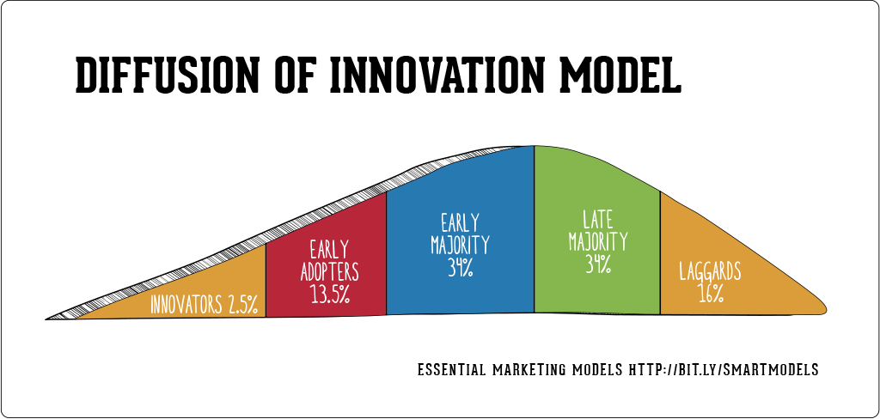
Notes:
The Diffusion of Innovation Model (Rogers, 1963) will be an important factor in moving forward with the Umbrella Initiative. This model accepts the necessity of recognizing social leaders in order to enact lasting change. When we address cultural concerns, such as Transgender issues, most efforts are initially only able to reach the innovators (the people already involved and passionate about the issue), which include the smallest amount of the population. For the change to be successful, we must also gain the assistance and buy-in from other groups. The first group to win over are the early adopters, these are the people within the population who can get behind the issue and spread their influence within their social group. If enough support is garnered from this population (around 13.5%), we can reach critical mass, at which point the initiative will be able to successfully support itself as people spread and support the message on their own, making it a norm in the culture. Thus, when targeting early adopters, it is important to first reach out to the social leaders. It is important to distinguish them from people with official leadership. In fact, these could be the people who traditionally don’t get involved, the people who host parties or bounce between social groups. These are the people who suggest Chinese food for dinner and suddenly everyone wants Chinese. By earning the buy-in from these groups of people, our initiative is able to break through certain barriers and shatters the norm of these programs having to be focused on staff talking down to students, allowing students to assist and educate others.

Slide 12
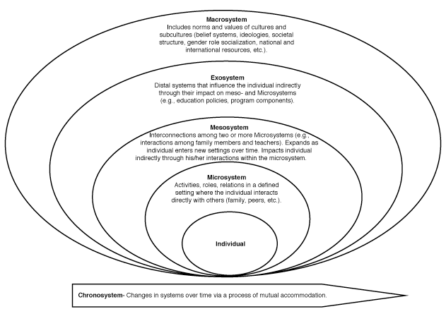
Bronfenbrenner’s Development Ecology Model
Addresses the process of creating change.
Each system can influence the next.
By influencing individuals, we can influence other people in the culture, and then eventually the culture itself.
We must empower the people in our community to be supportive in making the change.
Evans, N.J., Forney, D.S., Guido F.M., Patton, L.D., & Renn, K.A. (2010). Student development in college: Theory, research, and practice (2nd ed.). San Francisco. San Francisco, CA: Jossey-Bass
Notes:
When combined with the Diffusion of Innovation Model, we can see that, by targeting the social leaders and early adopters, we are increasing the support we have in the community since they will be able to influence their own microsystems and mesosystems, which in turn enables the greater societal factors to be influenced.

Slide 13
Evidence of success
Each of the mentioned articles show success rates from businesses, universities, and communities that have utilized such models in the past.
A prime example of an initiative that has combined these approaches and created lasting change: Green Dot
This anti-violence initiative is showing early results of decreasing the amount of experienced violence by 50%. This is done through education, rebranding to be inclusive, and community buy-in.
Notes:
The Green Dot initiative has proven it is possible to change the culture. By utilizing the research this initiative is founded upon, we can also strive to adapt and create a program to make our university a more educated and inclusive environment.

Slide 14
Conclusion
Transgender students face unique struggles on a college campus, and it is our duty to provide a safe, inclusive environment for them.
By creating a brand (the Umbrella Initiative), we are gaining buy-in from students and faculty, and promoting an inclusive attitude towards transgender students and the community.
Notes:
In conclusion, it is important to recognize that transgender students face unique struggles and we need to ensure they feel safe and welcome on our campus. We feel that by creating the Umbrella Initiative, we are able to gain the buy-in we need to reach the goal of having a more inclusive community and feel to campus for transgender students.

Slide 15
Questions?
Notes:
Thank you so much for your time! We would now like to take the time to field questions.

Slide 16
References
Bloyd-Peshkin, S. (2015, September 29). The Tricky Matter of Gender Identification. Retrieved February 25, 2016, from http://www.huffingtonpost.com/sharon-bloydpeshkin/the-tricky-matter-of-gend_b_8209458.html
Coker, Ann L., Fisher, Bonnie S., Bush, Heather M., Swan, Suzanna C., Williams, Corrine M., Clear, Emily R., & DeGue, Sarah, (2014). Evaluation of the Green Dot Bystander Intervention to Reduce Interpersonal Violence Among College Students Across Three Campuses. Violence Against Women. DOI: 10.1177/1077801214545284
Evans, N.J., Forney, D.S., Guido F.M., Patton, L.D., & Renn, K.A. (2010). Student development in college: Theory, research, and practice (2nd ed.). San Francisco. San Francisco, CA: Jossey-Bass.
Hamrick, F. A., & Benjamin, M. (2009). Maybe I should--: Case studies on ethics for student affairs professionals. Lanham: University Press of America.
Rogers, E. M. (1962). Diffusion of Innovations. Valente, T. V. & Davis, R. L. (November 1999). Accelerating the Diffusion of Innovations Using Opinion Leaders. 55-67.

