Slide 1
OUTSIDE SPEAKERS AND EVENTS: GUIDELINES FOR HOGWARTS UNIVERSITY
Kate Lonardo*, Rachael Mearman, & Emma Walsh - Central Connecticut State University

Slide 2
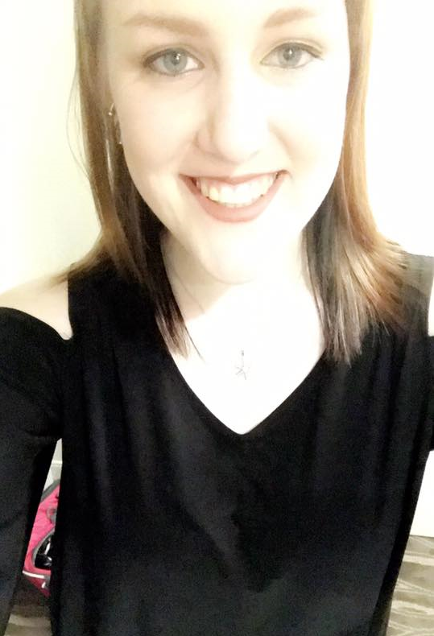
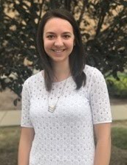
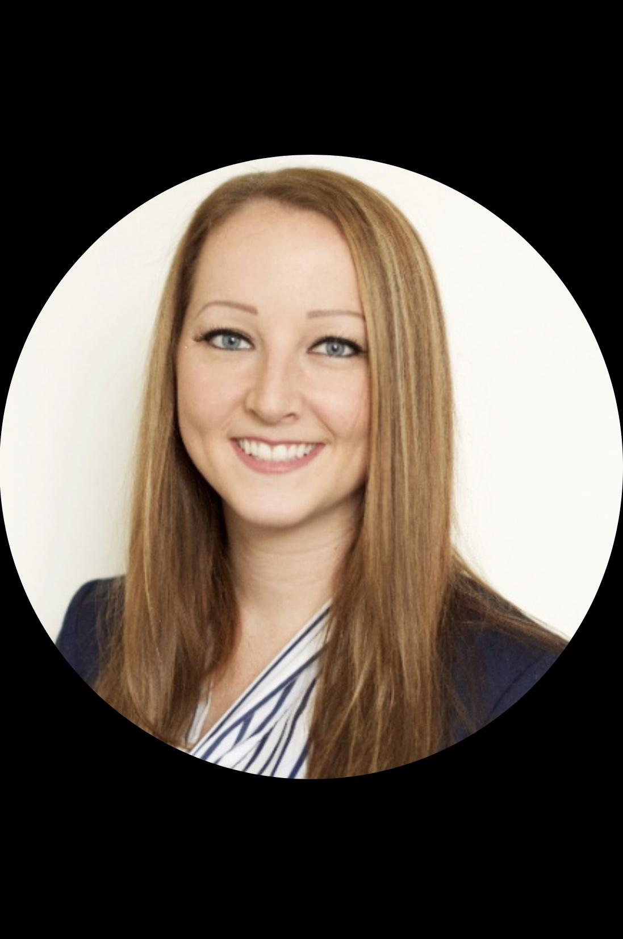
MEET THE TEAM
Kate Lonardo
2nd Year Graduate Student
Central Connecticut State University
Team Leader*
Rachael Mearman
2nd Year Graduate Student
Central Connecticut State University
Emma Walsh
2nd Year Graduate Student
Central Connecticut State University

Slide 3
AGENDA
Charge & Solution
Current Policies & Challenges
Assessment Form
Life Cycle of Request
Community Safety
Designated Free Speech Spaces
Political Related Events Guidelines

Slide 4
Charge
Solution
For the Office of Student Involvement to hold a mandatory workshop once a semester for members of student organization executive board members as well as faculty and staff members that are interested in bringing an external speaker/event to campus
Topics covered will include:
Assessment Form
Life Cycle of Request
Community Safety
Designated Free Speech Spaces
Political Speaker Guidelines
To revise the guidelines and processes for bringing outside speakers and events to Hogwarts University to ensure community safety while still protecting the First Amendment

Slide 5
Current Policies
Student organizations, faculty, and staff are allowed to invite any speaker of their choosing
Procedures surrounding bringing a guest speaker to campus include scheduling (to ensure that there are not any conflicts) and facilities (to ensure that the proper facilities are used) only
It is to be made clear that the views expressed by the speaker are not endorsed by Hogwarts University
Challenges:
Community safety is not taken into consideration
Outside speakers and event requests are not brought to the attention of the administration
There are not designated spaces for outside speakers and events

Slide 6
Event/External Speaker Request Form
Who: Is there planned to be a speaker at the event? Yes/No
Is the speaker considered to be controversial with regards to their reputation, political views, religious views? Yes/No
Is the audience restricted to University of Hogwarts students
and staff only? Yes/No
What: Is the topic potentially controversial? Yes/No
Where: On which designated free speech space would you like to hold
this event? ________________
When: What date and time would this event be held? _______________
Why: Please explain the benefits this event and/or speaker can bring to
Hogwarts University. _____________________________________
Assessment Form:
*To be completed by a university faculty, staff, or student organization executive board member 2 weeks prior to an expected event

Slide 7
University Student Involvement Office makes the first decision:
Acceptable: The topic is uncontroversial and there are no controversial speakers
The topic is controversial but the audience is Hogwarts University staff only
Unacceptable: The topic is controversial and the event is open to the public
The topic is controversial and the speaker is controversial
All unacceptable events/external speakers are referred on to the University Special Events Committee for review.
Life Cycle of Request:

Slide 8
Hogwarts University must bear the obligation to ensure conditions of peaceful discussion
Hogwarts University safety officers will handle safety and security needs. All officers have the authorization to make arrest in accordance with local, state, and federal regulations.
Local and town police services will be notified of controversial speakers/events
Community Safety

Slide 9
Attendees will be informed of policies to stay safe at a public demonstration:
Planning safe routes to and from the demonstration
Always bring a partner and plan to meet if separated
Be prepared for unpredictable events
Be knowledgeable of crowd safety
Attendees
Protocol

Slide 10
The Hogwarts Physical Properties Department plays a key role in ensuring the environment is safe and secure:
-Maintains the University’s grounds and buildings
-Routine inspection of space
Building access is limited to students, faculty, staff, alumni, and invited guests
Exits are labeled clearly and easily accessible
Permission to book events or speakers is subject to specific approval
Designated Free Speech Spaces

Slide 11
A designated courtyard or plaza will constitute as an open place for speech and expression at Hogwarts University
There will be restrictions on the length of the event, blocking the roadways, or any amplification device that might interfere with community living
Free speech zones will involve rules to handle protests and petitions
Free Speech Zones

Slide 12
Political Related Event Guidelines
Permitted Activities
Voter Education
How to register to vote
Voting process
Absentee ballots
Candidate/Political Speaker Appearances
Debates

Slide 13
Voter Education
Student organizations have university support on education our student population on voting regulations
Events must be unbiased, and purely educational on the process of voting
Students can hold event educating students on how to vote when no longer residing in your home state, also known as absentee ballots
Student organizations can use Hogwarts University’s official name and seal for general voter education purposes
Student organizations can use university funding for general voter education purposes

Slide 14
Candidate/Political Speaker Appearances:
Student organizations will not have financial support from Hogwarts University
Student organizations must obtain proper approval from all necessary University of Hogwarts offices (i.e. University Police, Events Management, Facilities, etc.)
Student organization president must notify the Office of the President at least 72 hours in advance of the speaker’s appearance
Disclaimer must be provided on marketing materials, either electronic or printed
Hogwarts University’s official name or seal cannot be used in regards to political speaker appearances
Representatives from Hogwarts University must be available for the event to hold a post-event debrief discussion

Slide 15
Debates:
Student organizations must have approval from the Director of Student Activities to hold debate
If political public figure is participating in debate, guidelines for “Candidate/Political Speaker Appearance” must be followed
Transcript of debate
Fundraising for political candidates is strictly prohibited
Transcript of debate must be presented to Director or Student Activities once the debate is complete to keep on official record
Disclaimer must be provided on marketing materials, either electronic or printed

Slide 16
Example Disclaimer for Electronic & Print Materials
“This event is not endorsed by, or supported by, the University of Hogwarts, or any of its subsidiaries or its affiliates. The University does not endorse this speaker, presentation, or any expressed viewpoint.”

Slide 17
REFERENCES
http://www.acenet.edu/news-room/Documents/Memo-Political-Campaigns-2016.pdf
http://www.studentaffairs.pitt.edu/wp-content/uploads/2017/03/Event-Scheduling-and-Protest-Guidelines_reformatted.pdf
https://issuu.com/scsu/docs/scsustuhandbook2017r2withlinks
https://www.ed.ac.uk/university-secretary-group/prevent-duty/external-speaker-assessment-form
http://www.universitiesuk.ac.uk/policy-and-analysis/reports/Documents/2013/external-speakers-in-higher-education-institutions.pdf
https://www.higheredjobs.com/Articles/articleDisplay.cfm?ID=1304

