Slide 4
Notes:
We want to critique current practices to remain relevant, challenge our campus to engage in understanding their first amendment rights, and champion the great work that is being done, and will be done on our campus.

Slide 6
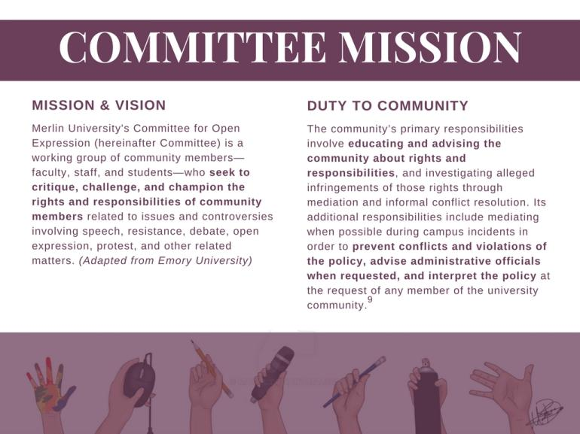
9
Notes:
We believe that having a strong mission is important when implementing change. This mission is the foundation for our proposed policy changes.

Slide 7
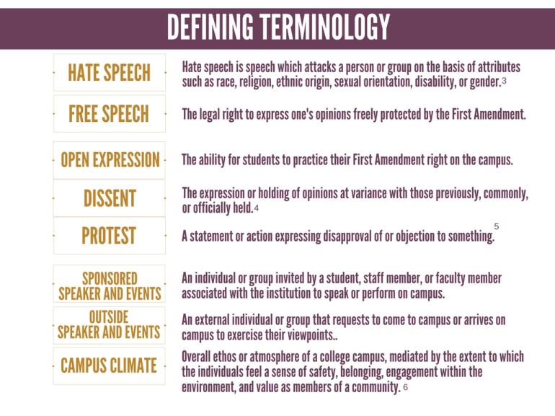
3
.
4
.
5
.
.
6
.
Notes:
These terms are commonly used when talking about policy regarding first amendment rights on a college campus. It is important for all involved in the process of reforming policy to work from the same definitions.

Slide 8
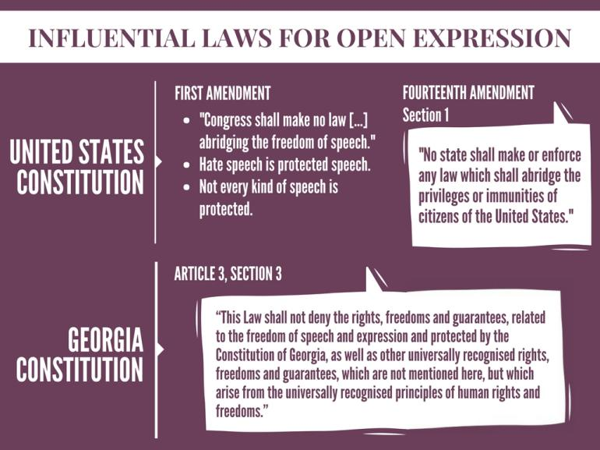
Notes:
While open expression is pertinent to creating policy on college campuses, it is also important to ensure campus policies comply with national and state laws.

Slide 9
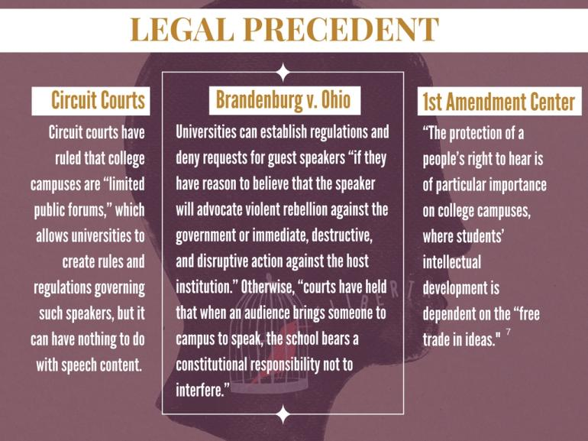
7
Notes:
These case law examples help provide a national context to Merlin University’s open expression policy reform.

Slide 10
Notes:
Here is an overview of the current policy, both what is currently being done well and what can be improved. We will discuss the current policy in further detail in the next two slides.

Slide 11
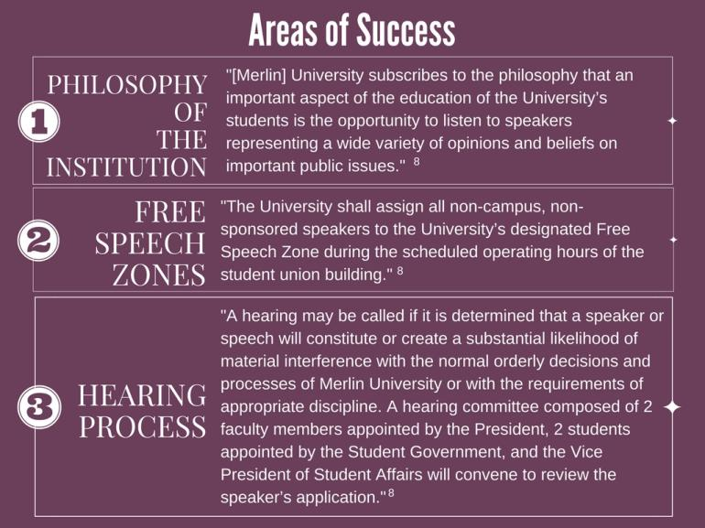
8
.
8
8
Notes:
Merlin University believes encouraging civil discourse, designating free speech zones, and providing a hearing process are all important ways to engage with free speech. Therefore, these are all aspects of the current policy our committee would like to keep.

Slide 12
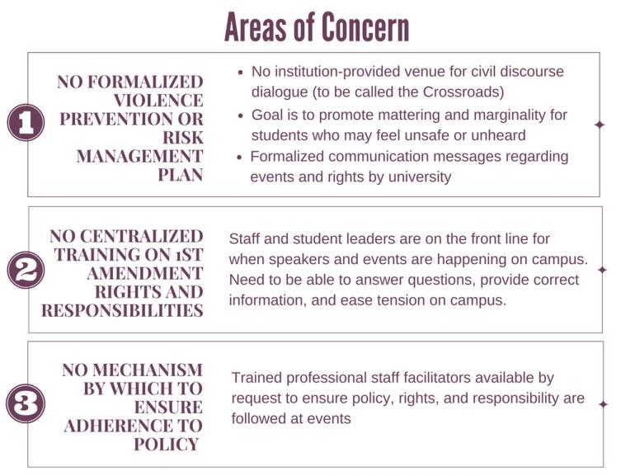
.
.
Notes:
We want to implement a risk management plan, provide training on rights and responsibilities, and train designated facilitators to help enforce the policy. We will go into further detail about our proposed changes in a few slides.

Slide 14
Notes:
Here is a quick overview of our proposed policy changes. Critique, challenge, and champion is our committee’s motto for intentionally thinking about appropriate policy changes regarding open expression and outside speakers. Each part of our proposed policy aligns with our committee’s motto.

Slide 15
Notes:
Step one of our three part proposal

Slide 16
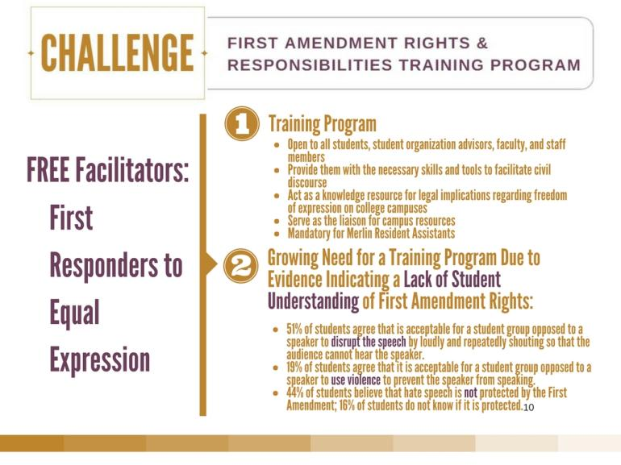
10
Notes:
Step two in our three part proposal: The students, faculty, and staff, who participate in the training program will become FREE Facilitators (First Responders to Equal Expression) and will act as a knowledgeable resource on campus. There is a need for this program due to a lack of education, as demonstrated by the statistics on our slide.

Slide 17
9
Notes:
Step three of our three part proposal.

Slide 18
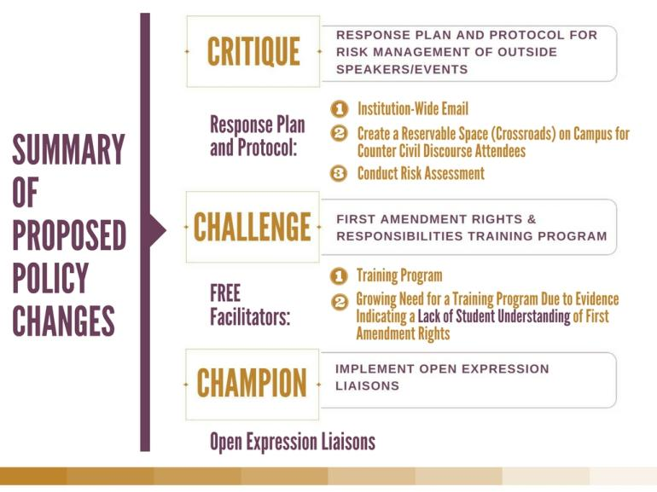

Slide 19
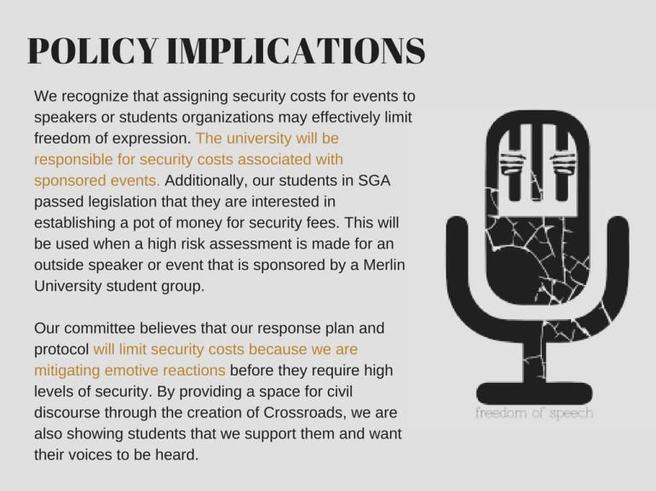

Slide 20
1
.
2
.
Notes:
These news headlines regarding controversial speakers, college campuses, and the first amendment are just 6 of many flooding the news today. This problem is not specific to Merlin University, but is plaguing the national conversation as well.

Slide 21
.

Slide 22
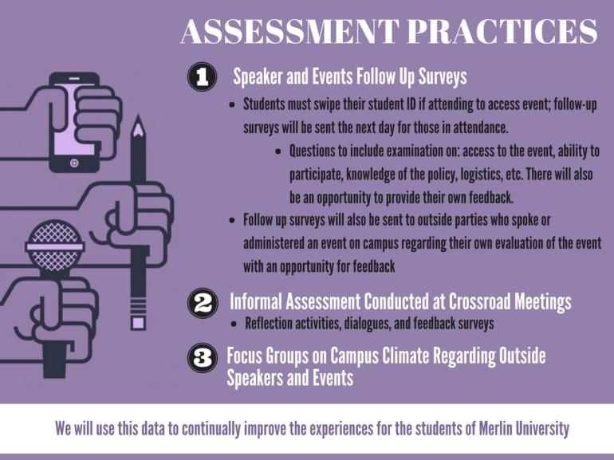
.

Slide 23
9

Slide 25
